Slide 1
Multiagent RL with Stochastic Game
Two players, zero sum game

Slide 2
Motivation
The work we are going to discuss in this paper has arisen and will be done in collaboration with one of the Israeli Aerospace Industries divisions
The problem will be described by the atmosphere of the Plants vs. Zombies game, A tower defense and strategy video game
Our goal is to achieve the highest score in a problem of two player zero sum stochastic game in a Markov environment where the transitions and one step payoffs are determined simultaneously

Slide 3
Description of the game
Imagine a board of zombies approaching from some locations in the left side of the board towards the right side
Above all that, there is a light that can be positioned anywhere on the board
The two agents will be called 'Zombie Master' and 'Light Master' the Zombie Master is responsible of positioning the zombies in the left side and determine their initial angle and speed that will stay constant for each zombie
The Light Master decides where to project his light in every turn

Slide 4

Basic assumptions
Discrete time and space
The system area is represented with $N×M$ grid
The zombie and light might take coordinates on the integer grid
At each time moment a zombie can move one cell in right direction
The mark (light) is represented by a square area $A×A$

Slide 5

Example 1 – simple table
Properties:
Grid: $8×8$
Light: $3×3$

Slide 6

Player 1 – Zombie Master
Objective:
Maximize average lifetime of zombies
Action space:
Decide coordinate y, where the next zombie should start
Available information
Matrix of zombie locations $N×M$
Each cell in the matrix is 0 (no zombie) or 1 (occupied by zombie)
For all the history, $(t×N×M$ | t – current time)

Slide 7

Player 2 – Light Master
Objective:
Minimize average lifetime of zombies
Action space:
Decide coordinates (x, y), where to put the center of the light
Available information
A 2-d matrix of zombie locations and strength:$2×N×M$
Each cell in the first matrix (positions of zombies) is 0 (no zombie) or 1 (occupied by zombie)
Each cell in the second matrix (strength of zombies) is with non empty cells at the zombies locations
For all the history, $(t×2×N×M$ | t – current time)

Slide 8

Game play
There is an environment-clock which ticks every $△t$
For each environment-clock tick
Move all zombies by one cell to right direction
Zombie Master takes action
Light Master takes action
Heal/damage the zombies that are outside/inside the light
Get reward from the environment and let the agents learn

Slide 9

How do we get reward from the environment?
Every zombie has some hits value - $h$
When a zombie reaches the right side of the board (finishes the game), we flip a non-fair coin with some probability of falling to some side (depends on $h$ value).
The coin will determine if the zombie will leave or die
Greater the $h$, greater the chances of zombie to die
Finally, the reward for the light master is some function of the amount* of zombies that managed to end the game and stay alive after the described process
The reward for the zombie master is the negative sign of that (zero-sum game)
* For the simplest case, in general – could be different

Slide 10
GVG-AI competition
The GVG-AI Competition explores the problem of creating controllers for general video game playing
Since 2014
Vast community with successful results
60 Atari games converted to 2-player games
Ghostbusters
Upgrade-X

Slide 11
Ghostbusters
Players:
One player is the ghost
The other is the hunter
Actions:
The ghost can pass through walls and wraps around the level
The hunter shoots missiles and moves faster than the ghost
Goal:
The aim of the ghost is to either avoid dying or catch the hunter
The goal of the hunter is to avoid the ghost that can hurt him and shoot the ghost

Slide 12
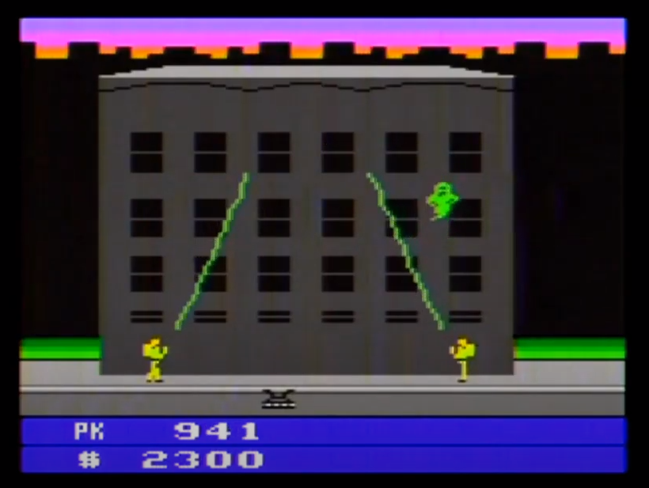
Ghostbusters

Slide 13
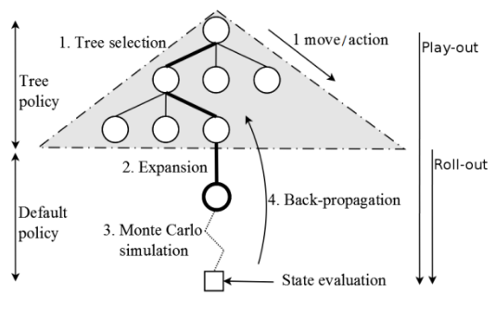
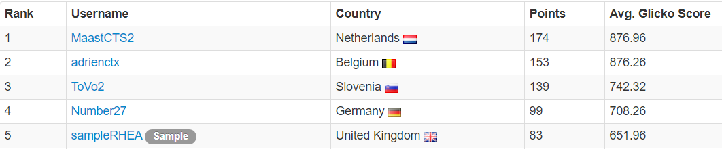
Algorithms
Adrienctx’ agent uses algorithm called MCTS
MaastCTS2 agent uses algorithm called MaastCTS2
MCTS-based agent with a number of enhancements

Slide 14
Upgrade-x
Environment:
There is an area for each player that they can’t leave
Two players (agents)
Actions:
They have some laser cannons, which they can move around
If they run into a laser, they lose health points
Goal:
The winner is the player that survives or the one with most points at the end of the game

Slide 15
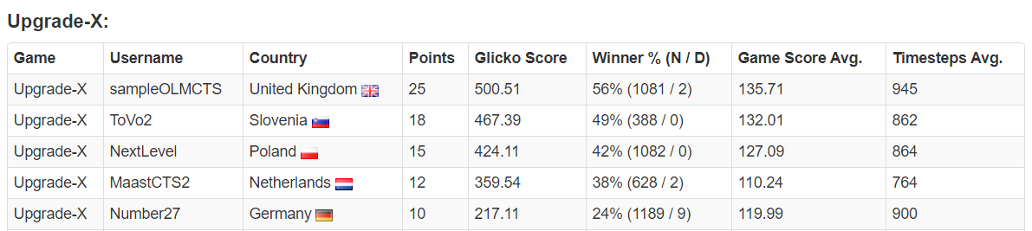
Algorithms
sampleOLMCTS’ agents uses OLMCTS algorithm (without code or elaboration)
ToVo2’s agent uses SARSA-UCT algorithm
NextLevel’s agent uses OLMCTS equipped with a state heuristic based on features of objects
MaastCTS2 agent uses algorithm called MaastCTS2
MCTS-based agent with a number of enhancements

Slide 16

Towards example 2 – our model
Settings:
Grid: $8×16$
Light: $3×3$
Agents:
Both agents take random actions

Slide 17
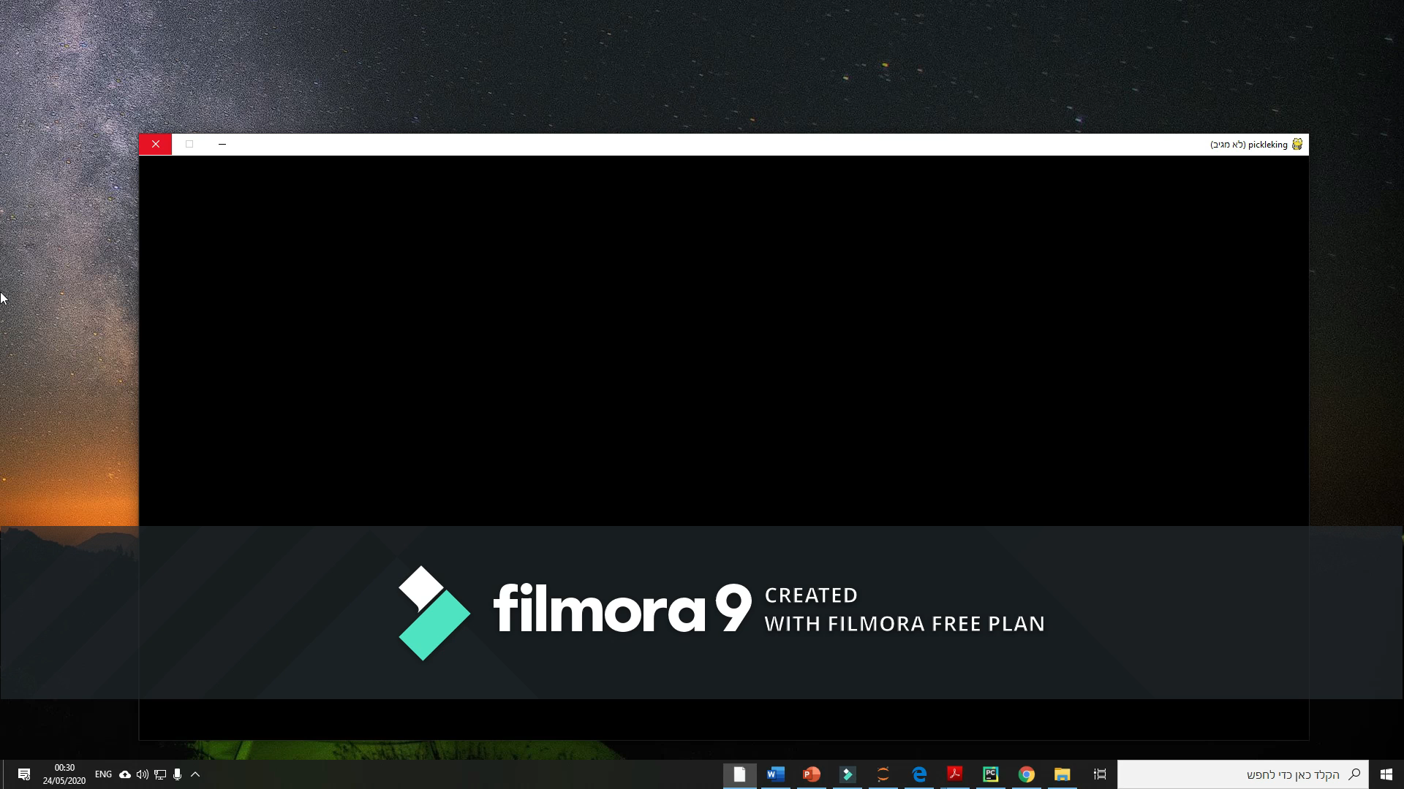
Example 2 – visual framework

Slide 18
What’s next?
Build the entire environment of the game
will contain two agents' possible interactions
will be compatible with the openAI gym framework to enable potential of wider research.
Examine the algorithms :
DQNs – basic and successful
MCTS – from the tree search area
Combining RL with MCTS – GVG-AI competition (alphaGo*, MaastCTS2, OLMCTS, SARSA-UCT etc.)
DEC-HDRQNS – proven successful
Test the results over a different utility and reward functions
Increase degree of simulation precision
Consider round markings, finer resolution, continuous coordinates etc.

